Slide 1
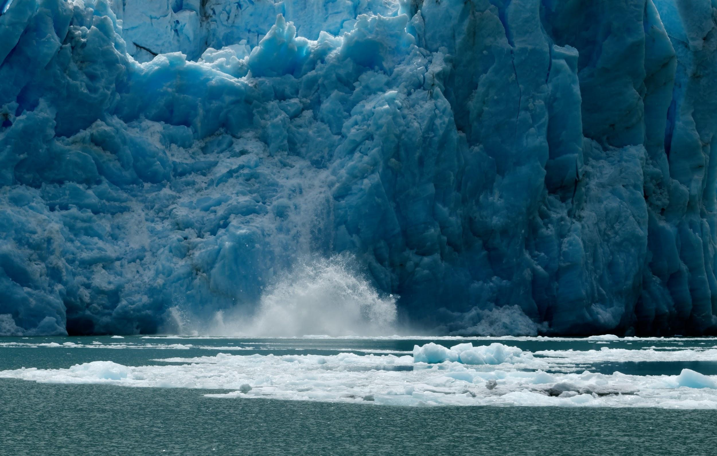
Climate Change
Andrea Leitereg, Matthew Ryder, Andrea Smith, Raya Young
Notes:
Andrea S.

Slide 2
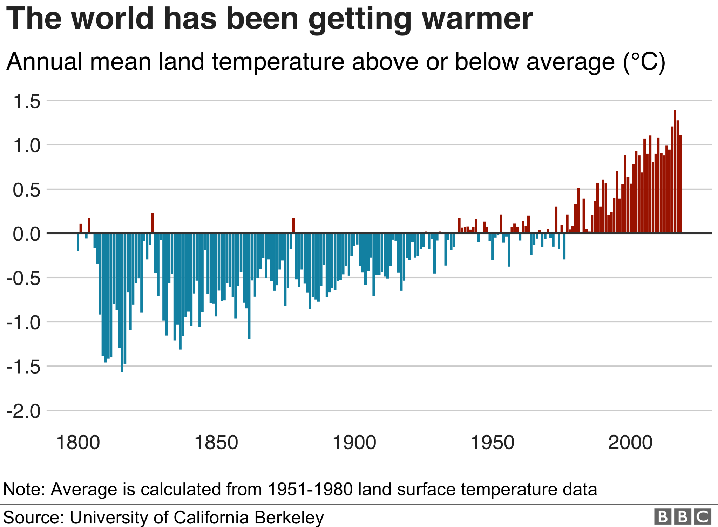
Climate Change: What is it?
Average temperature of the earth is increasing rapidly
Increased carbon emissions have contributed to this rise
Notes:
Andrea S.
Avg temperature of the earth is increasing rapidly
Increased carbon emissions has contributed to this rise
Burning of fossil fuels
Esp from industrial and agricultural sectors

Slide 3
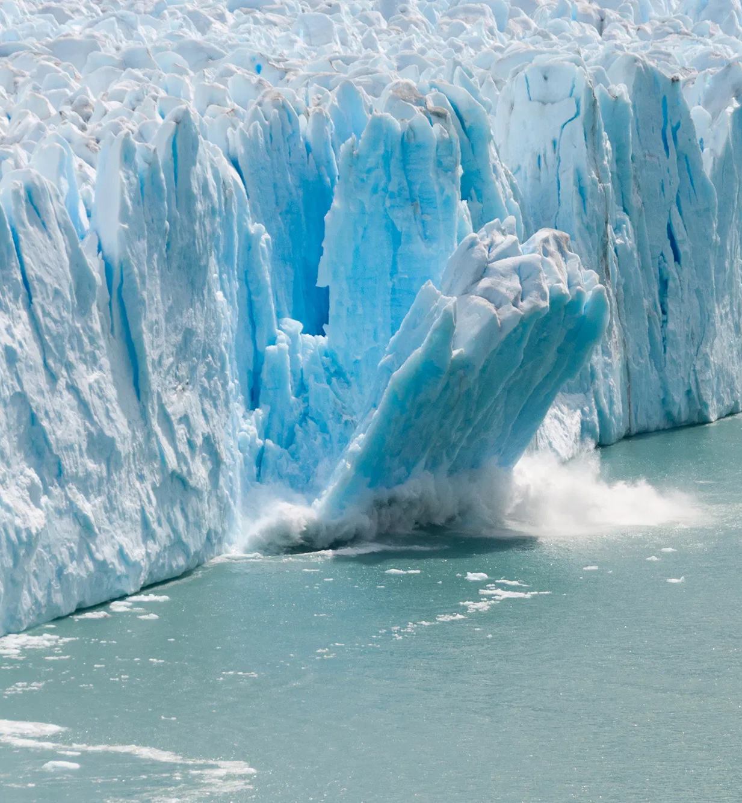
Current state of the climate
Warmest years on record
Average sea levels are increasing & glaciers are retreating
Impacts on plants & animals
Extreme weather events
Notes:
Andrea L.
What is the current state of the climate?
Warmest years on record
Nineteen of the warmest years have occurred since 2000 (record keeping started in 1880)
Average sea levels increasing at a rate of 3.3 millimeters per year
Due to expansion of water as it warms & glaciers/ice sheets melting
Plants & animals
Plants are flowering earlier
Extended growing seasons
Plants no longer able to grow in certain regions
Animal migrations
As Andrea S mentioned, extreme weather events

Slide 4
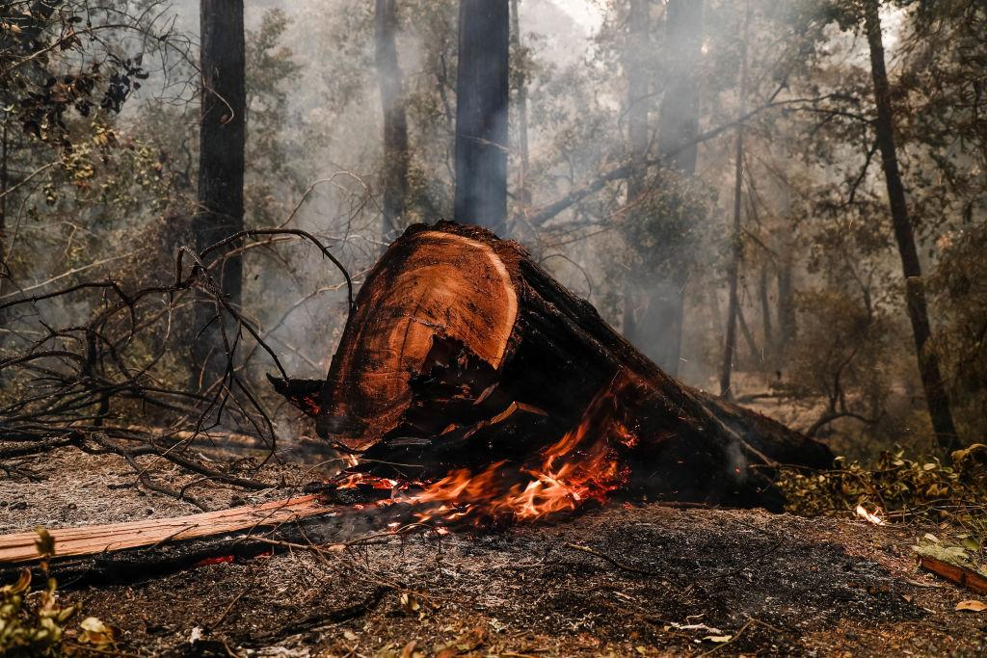
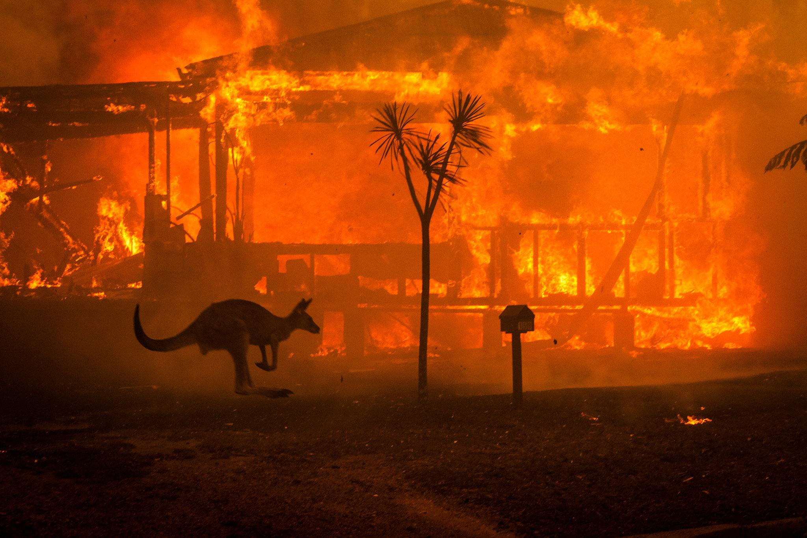
Notes:
Andrea L.
Current state cont’d
For example: 2020 wildfires in California and Australia
Human casualties, destruction of nature, including centuries-old redwoods in Big Basin State Park, animal displacement (AUS wildfires killed and displaced an estimated 3 billion animals)

Slide 5
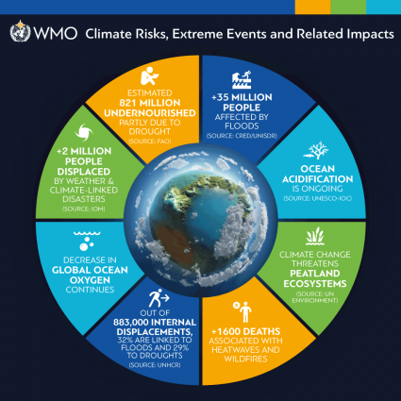
Why it matters in the long run
Increase in extreme weather and climate events
Food security
Displacement
Air quality & health
Environmental impacts
Risk of armed conflicts
Economic impacts
Notes:
Andrea L.
Why does it matter? We will continue to see the impacts mentioned before as well as new ones.
Increase in extreme weather and climate events; they will start happening more frequently
Natural disasters such as floods, hurricanes, heatwaves, wildfires
Food security
Agriculture affected by droughts
Rise in world hunger
Displacement
Droughts, floods, storms like hurricanes/cyclones lead to displacement
Air quality & health
Exposure to heatwaves
Bad air quality due to wildfires
Environmental impacts
Loss of coastal and peatland ecosystems, among others
Coral bleaching, reduced oxygen levels in the ocean
Risk of armed conflicts
One study estimates climate has influenced between 3% and 20% of armed conflict risk over the last century
If we keep going as we are now and temps rise 4 degrees Celsius, the influence of climate on conflicts would increase to a 26% chance of a substantial increase in conflict risk
Economic impacts
Prices of food and consumer goods will increase

Slide 6
What we are investigating
How has twitter conversations on climate changed over time? Are there differences with these conversations within different regions of the earth?
What are the trends in popularity; Is there a seasonality or spike in this topic over time? Current events like wildfires, floods, and other natural disasters may naturally cause a spike in discussion either indirectly or directly.
Is there a correlation between conversations about the emission of greenhouse gases and global temperature?
Notes:
Raya Y.

Slide 7
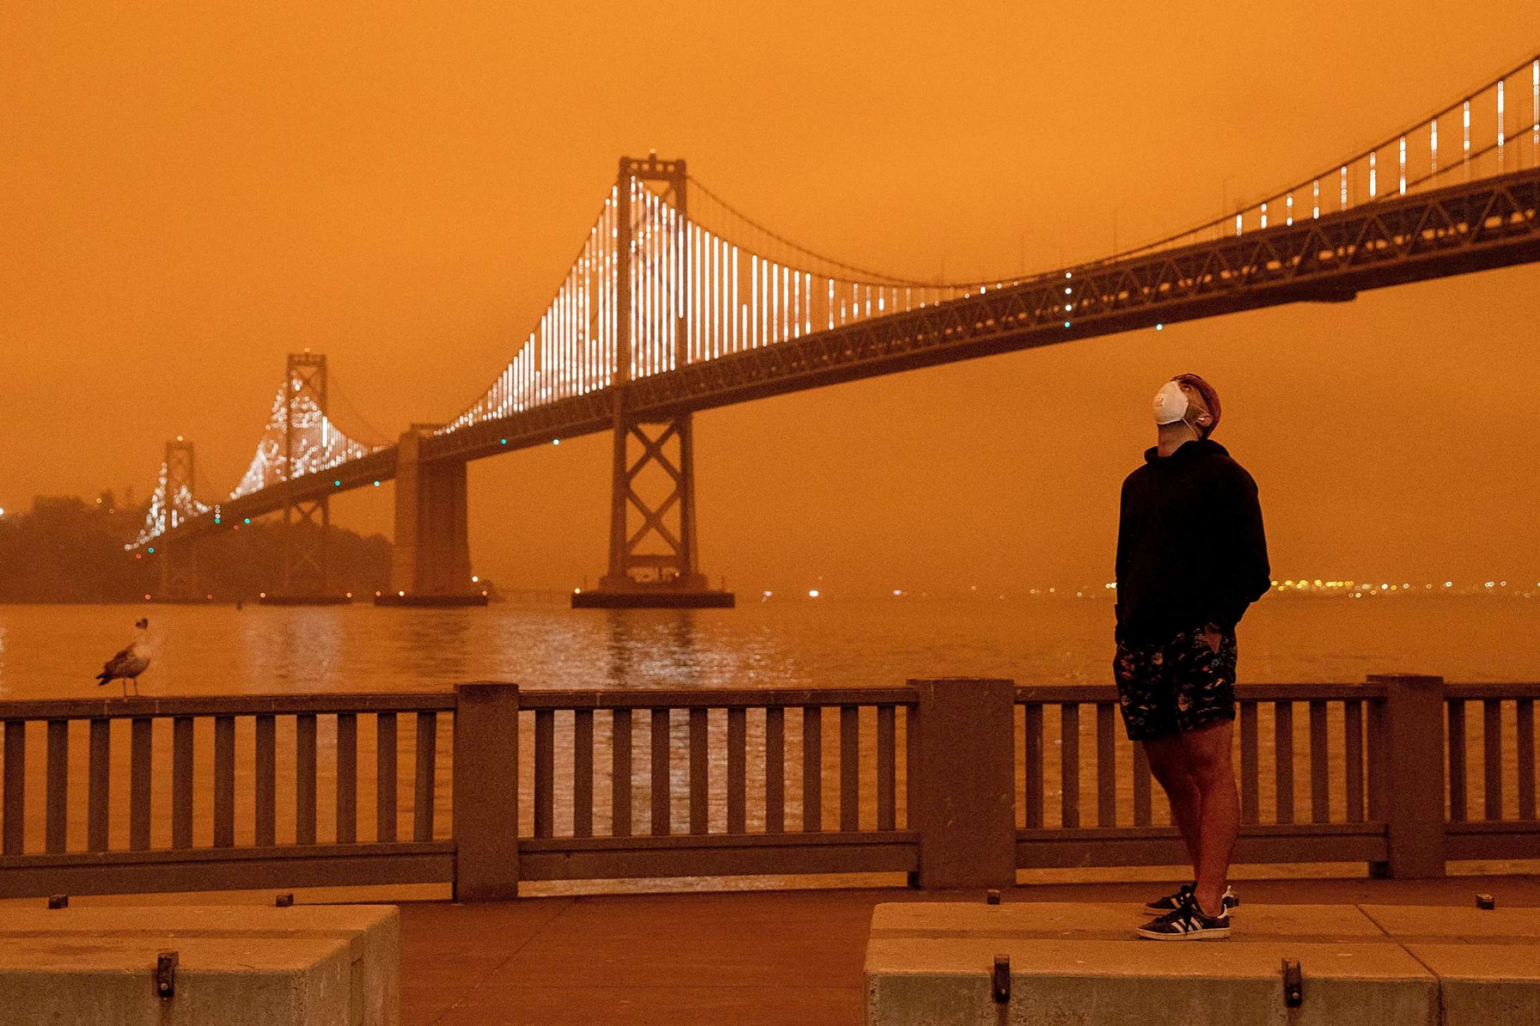
An image from the SF Chronicle depicts the orange skies seen in September 2020, due to smoke and wildfires.
Notes:
Raya Y.

Slide 8
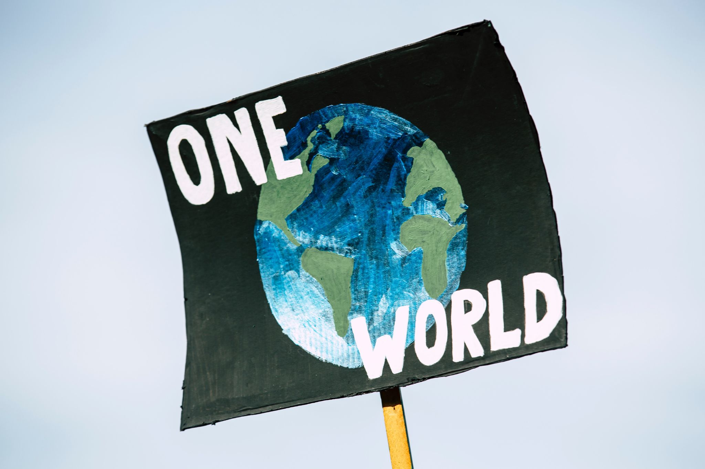
What we are investigating
What are believers of global warming tweeting about why they believe global warming is real vs what non-believers of climate change are tweeting?
What overall sentiment of climate change according to tweets?
How are people feeling? helpless, mobilized, political, angry?
What solutions are trending in the discussion around climate change? Individuals vs. policy
Notes:
Matt R.

Slide 9
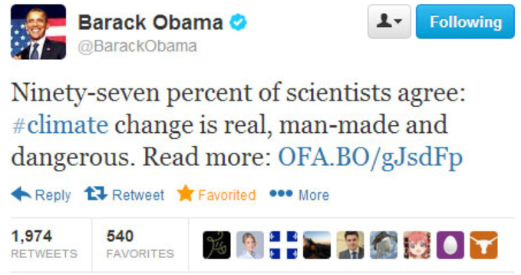
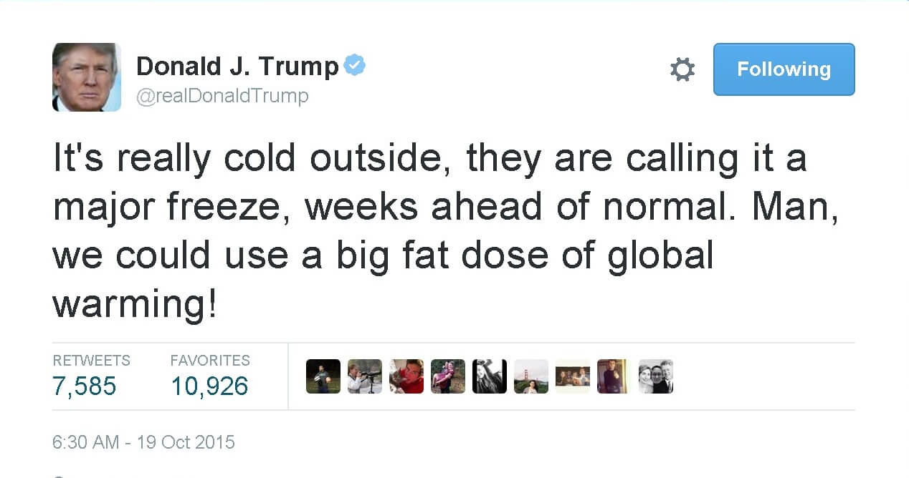
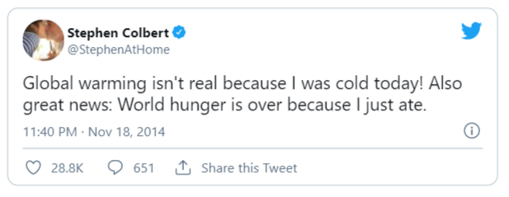
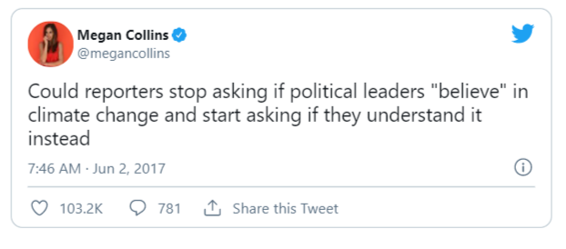
Popular Tweets
Notes:
Matt R.

Slide 10
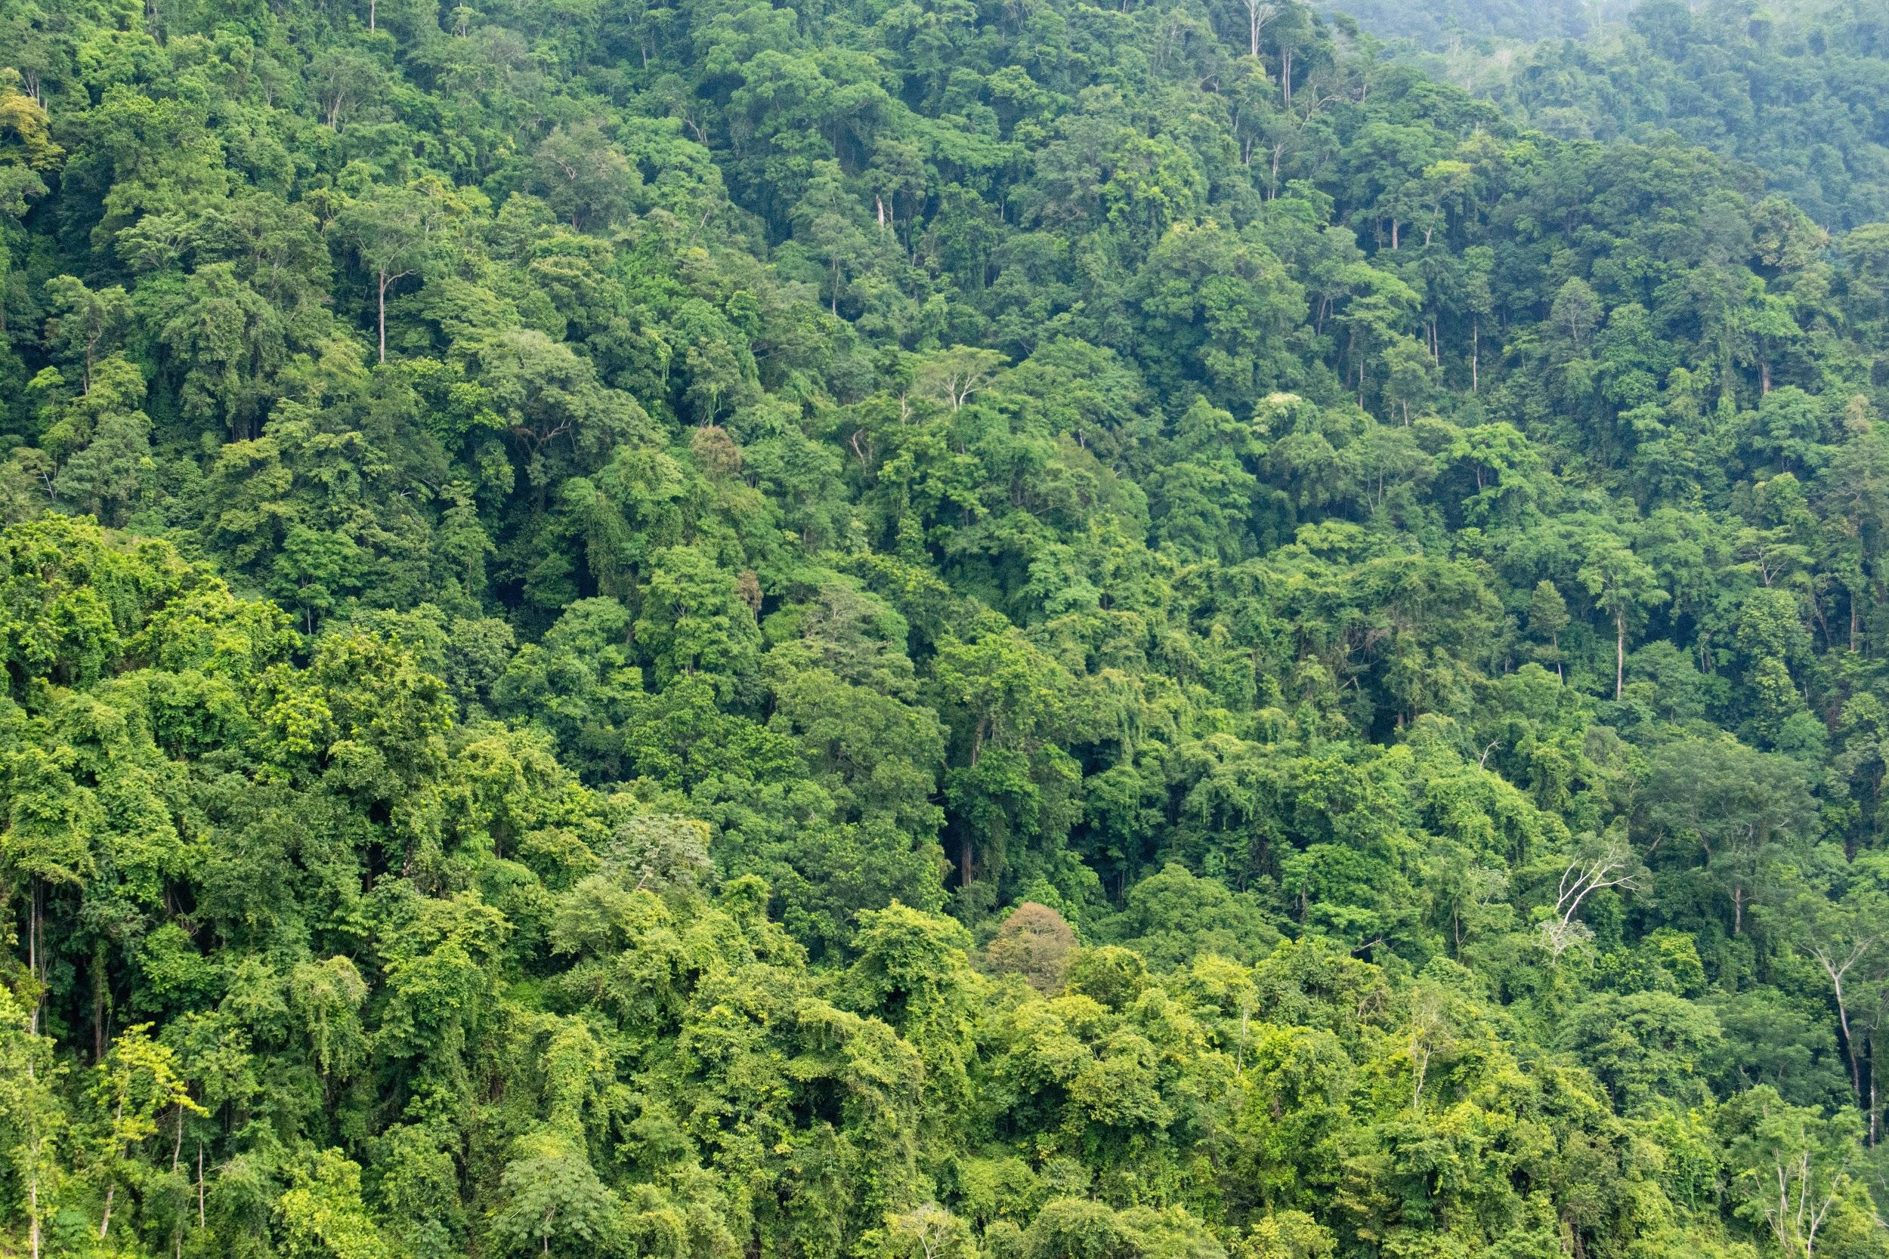
About the Data

Slide 11
Analysis - About the Data
Tweets were scraped with an API and Tweepy, using the following hashtags:
#climatechange, #globalwarming, #climatechangehoax, #climatechangefraud, #globalwarminghoax, #climatecrisishoax, totalling 2066 tweets. Of these, 1907 in English.
Another collection focusing on climate change solutions was gathered under the hashtags #climatesolutions, and #climatepolicy, totalling 645 tweets. Of these, 572 in English.
Tweets were collected in a MongoDB, and output to .csv format for further processing, like removing certain characters and stopwords.

Slide 12
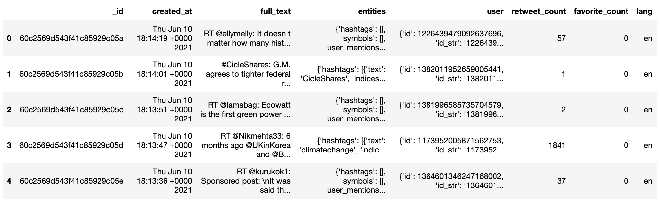
Analysis - About the Data
Formatted into a pandas dataframe, columns names are “_id”, “created_at”, “full_text”, “entities”, “user”, “retweet_count”, “favorite_count”, and “lang”

Slide 13
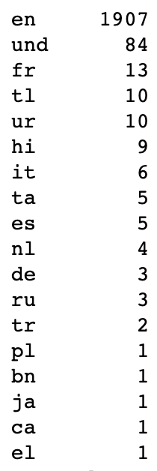
Analysis - About the Data
18 Languages represented in the data (Twitter supports 34 languages in total) - Mostly English; 84 tweets could not identify a language, and others include French, Urdu, Hindi, Italian, Spanish, etc.
Notes:
developer.twitter.com/en/docs/twitter-for-websites/supported-languages

Slide 14
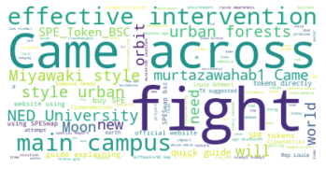
Analysis - About the Data
Word Cloud of Most Frequently Used Terms for main collection (317392 words)

Slide 15
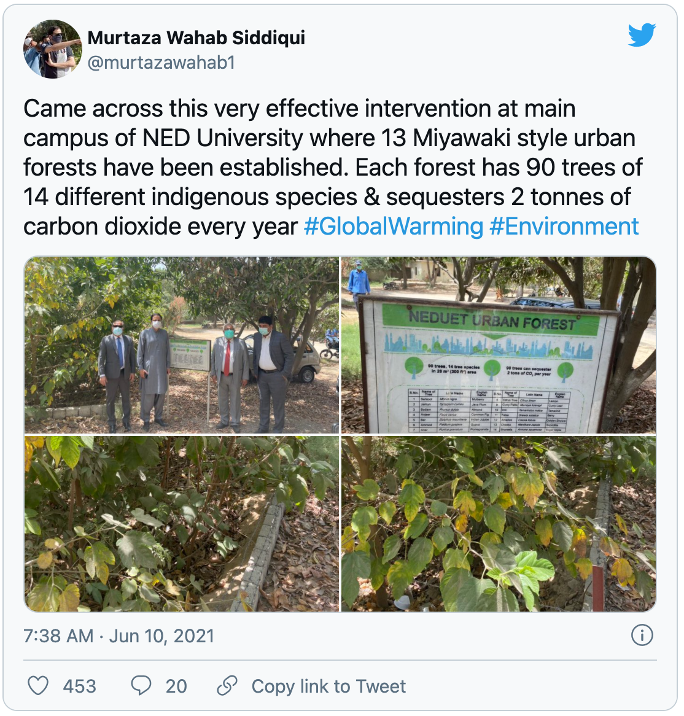
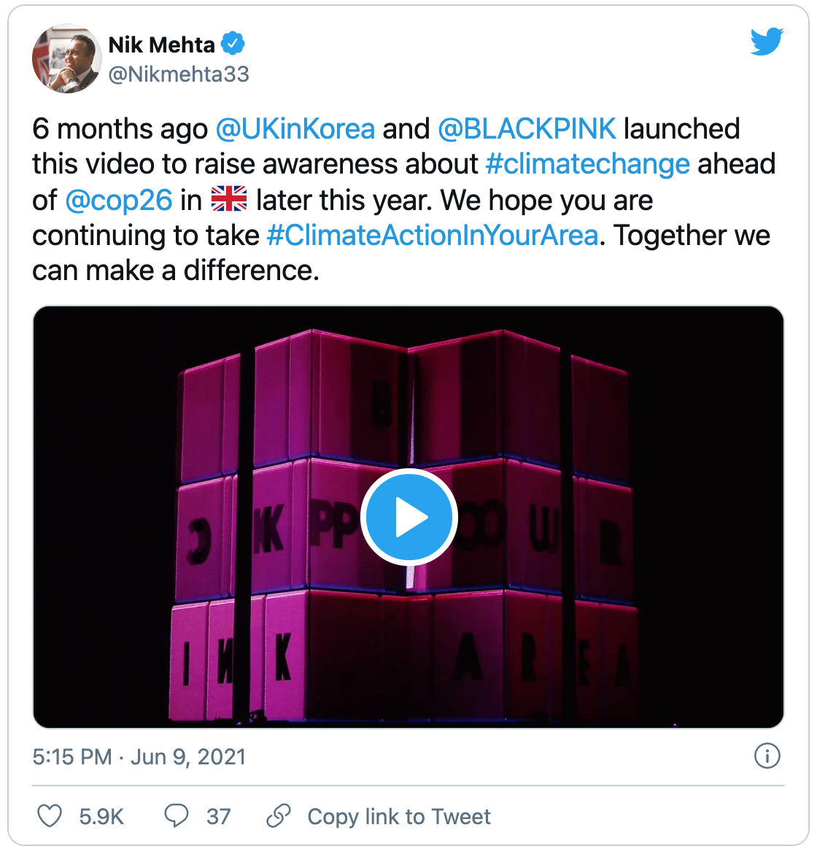
Analysis - About the Data
Notes:
Top Favorited Tweet (309 -> 453); and Top RT (53,389)
RTs (quotes) are cut off from the original, so the original tweet (with most RTs) is seen here.
BLACKPINK (KPOP) has a far-reaching audience and is using their influence to spread the message.
<https://twitter.com/Nikmehta33/status/1402766438683713537?ref_src=twsrc%5Etfw%7Ctwcamp%5Etweetembed%7Ctwterm%5E1402766438683713537%7Ctwgr%5E%7Ctwcon%5Es1_c10&ref_url=https%3A%2F%2Fpublish.twitter.com%2F%3Fquery%3Dhttps3A2F2Ftwitter.com2FNikmehta332Fstatus2F1402766438683713537widget%3DTweet>

Slide 16
Climate Change Believers & Skeptics

Slide 17

Questions for Investigation
What are climate change believers and skeptics tweeting about?
Do they talk about climate change in similar or different ways?

Slide 18
Analysis Approach
Trained two multinomial Naive Bayes models
Hand labeled tweets
Cleaned & vectorized data
Examined what the models learned about the data
Notes:
Hand labeled 127 tweets with either a yes (believer) or a no (skeptic)
Cleaned & vectorized data using word frequency and TF-IDF
Trained a multinomial Naive Bayes model on both data frames
Examined what the model learned about the data
Processing & analysis challenges
Challenges:
Skew in the raw dataset--way more “believer” tweets. Had to pull multiple samples from the main dataset to fill in the “skeptic” tweets and reduce model bias.
Key word features related to climate change (G7, COP26) were tricky to keep from getting cleaned out of the dataset, had to adjust regular expressions to keep some of them in.

Slide 19
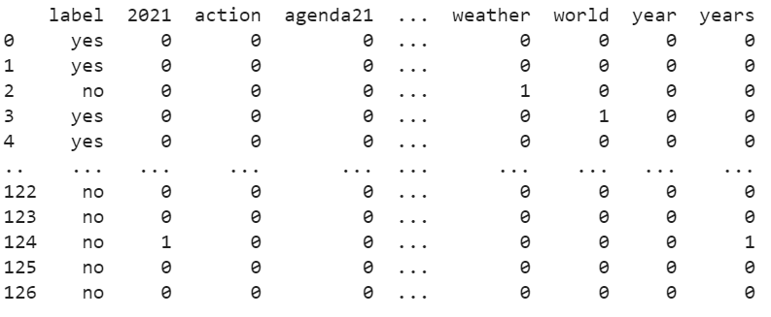
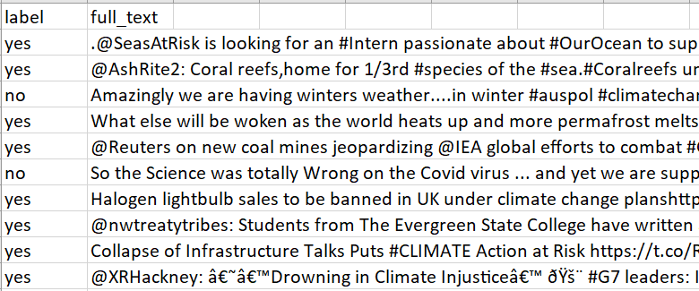
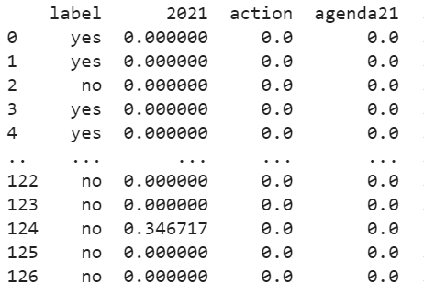
Notes:
Raw data to vectorized data frame (word frequency & tf-idf)

Slide 20
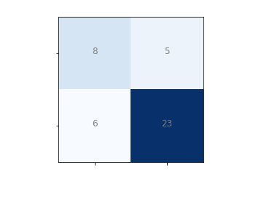
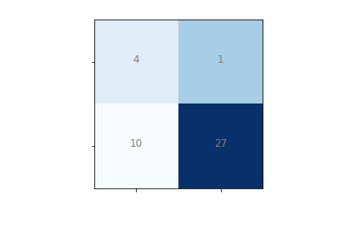
Results
Notes:
Trained model on 66% of the data and tested on 33%
Assessed accuracy using a hold-out test
Both models scored an 74% accuracy (31/42)
The main errors in the TF-IDF model were almost all scoring skeptics as believers.
The word frequency model scored more believers as skeptics compared to the TF-IDF model;
Low accuracy potentially due to skew in the data--more believer tweets than skeptic tweets.

Slide 21
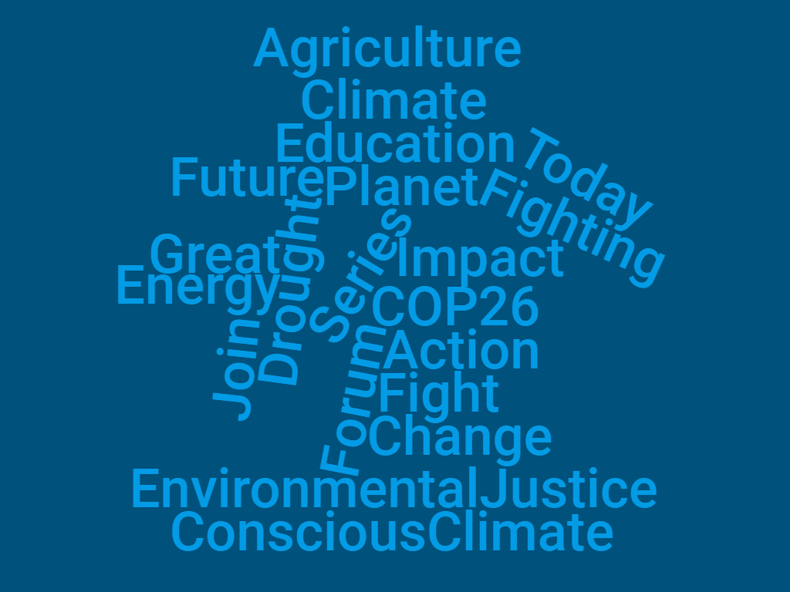
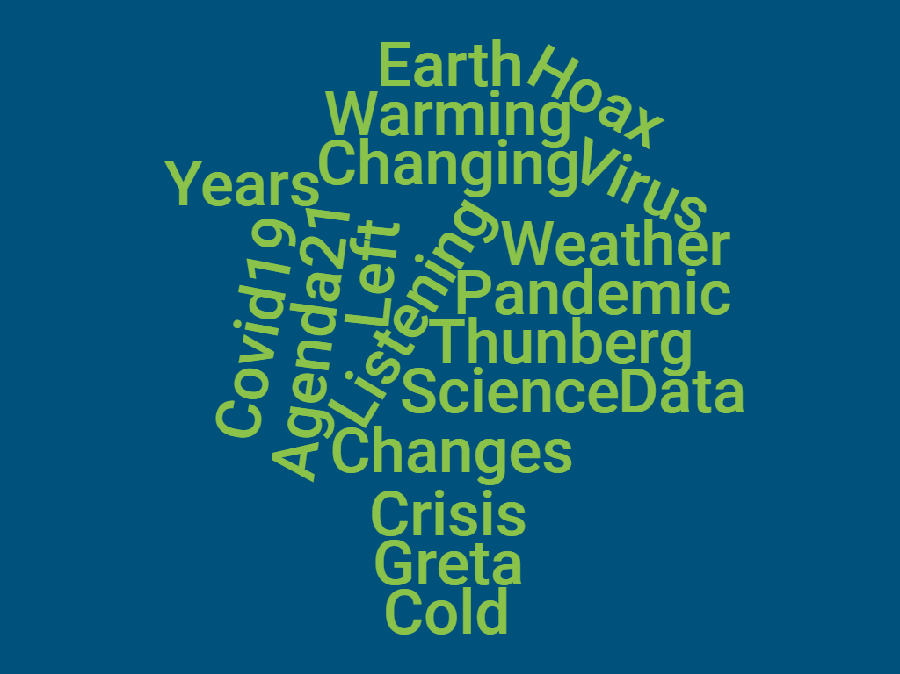
Believers
Skeptics
Notes:
What the model learned (most indicative words)
Climate change vs. global warming
Skeptics use “global warming” more than believers; linked to skeptics’ arguments around abnormally cold weather = climate change/global warming isn’t happening.
Believers: Active verbs; action, fight/fighting, join. Looking to the future. COP26. Intersection of climate change & social justice. Current climate emergencies: CA drought.
Skeptics: Greta Thunberg. Data/science--calling out fake/fudged data. Covid-19/Virus.
Agenda21: Theorists argue that Agenda 21, a 23-year-old non-binding UN resolution that suggests ways for governments and NGOs to promote sustainable development, is the linchpin in a plot to subjugate humanity under an eco-totalitarian regime.

Slide 22
Climate Change Sentiment

Slide 23
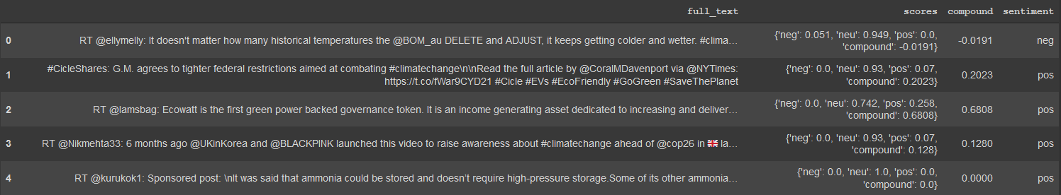
Sentiment Analysis- VADER

Slide 24
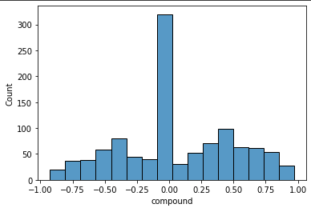
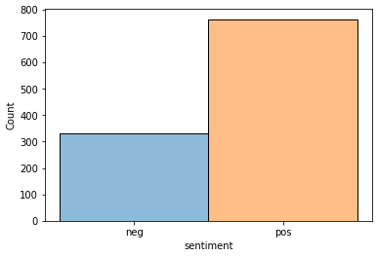
Sentiment Analysis Results

Slide 25
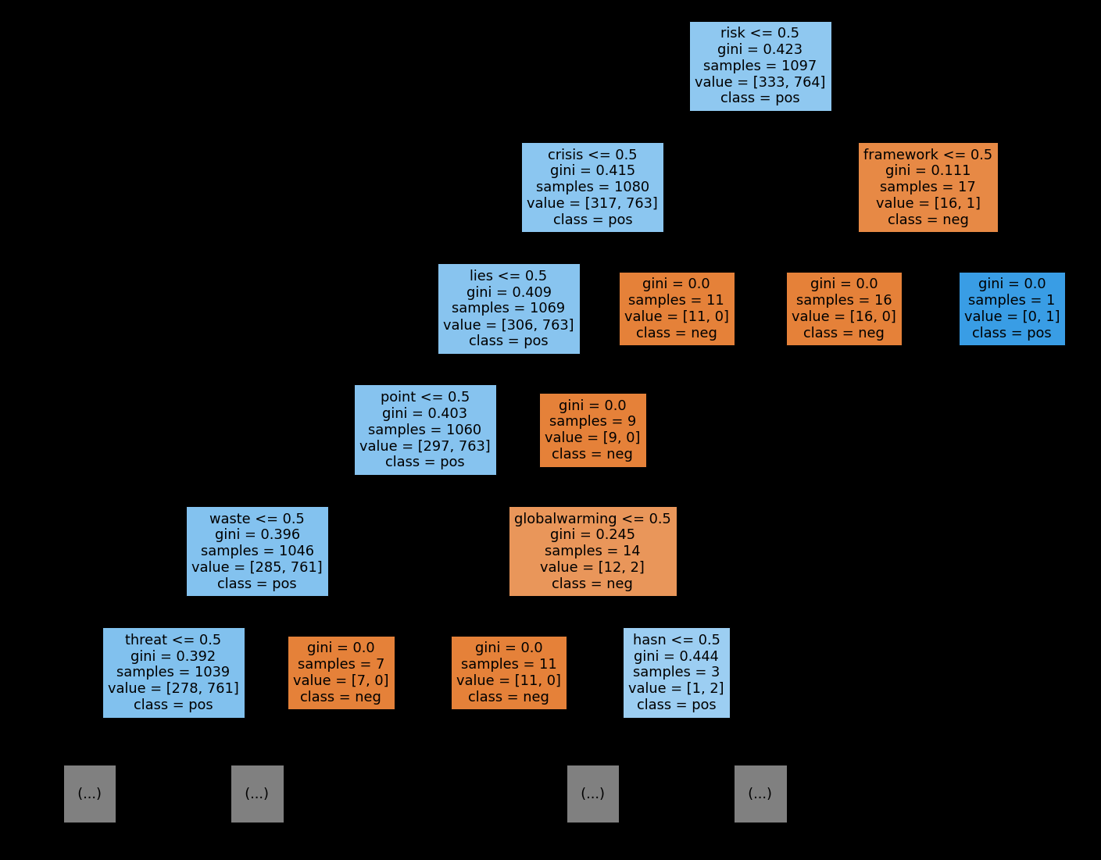
Vader Feature Importance

Slide 26
Climate Solutions

Slide 27
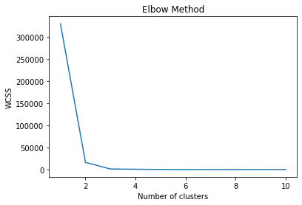
Clusters
Cluster 1
Bill
Clean
Cosponsor
Ensure
Floor
Futures
Please
Vote
Cluster 2
Climate
Cluster 3
Carbon
ClimateSolutions
Drawdownga
Notes:
Inspired by project drawdown, there is movement in georgia to accelerate progress toward net greenhouse gas emissions. If we cut georgia’s carbon impact by at least ⅓ by 2030.

Slide 28
Analysis Approach
Ran a cluster analysis
Cleaned & Vectorized (TFIDF)
Visualized the data
Examined the high frequency terms and what the cluster learned
Notes:
Hand labeled 127 tweets with either a yes (believer) or a no (skeptic)
Cleaned & vectorized data using word frequency and TF-IDF
Trained a multinomial Naive Bayes model on both data frames
Examined what the model learned about the data
Processing & analysis challenges
Challenges:
Skew in the raw dataset--way more “believer” tweets. Had to pull multiple samples from the main dataset to fill in the “skeptic” tweets and reduce model bias.
Key word features related to climate change (G7, COP26) were tricky to keep from getting cleaned out of the dataset, had to adjust regular expressions to keep some of them in.

Slide 29
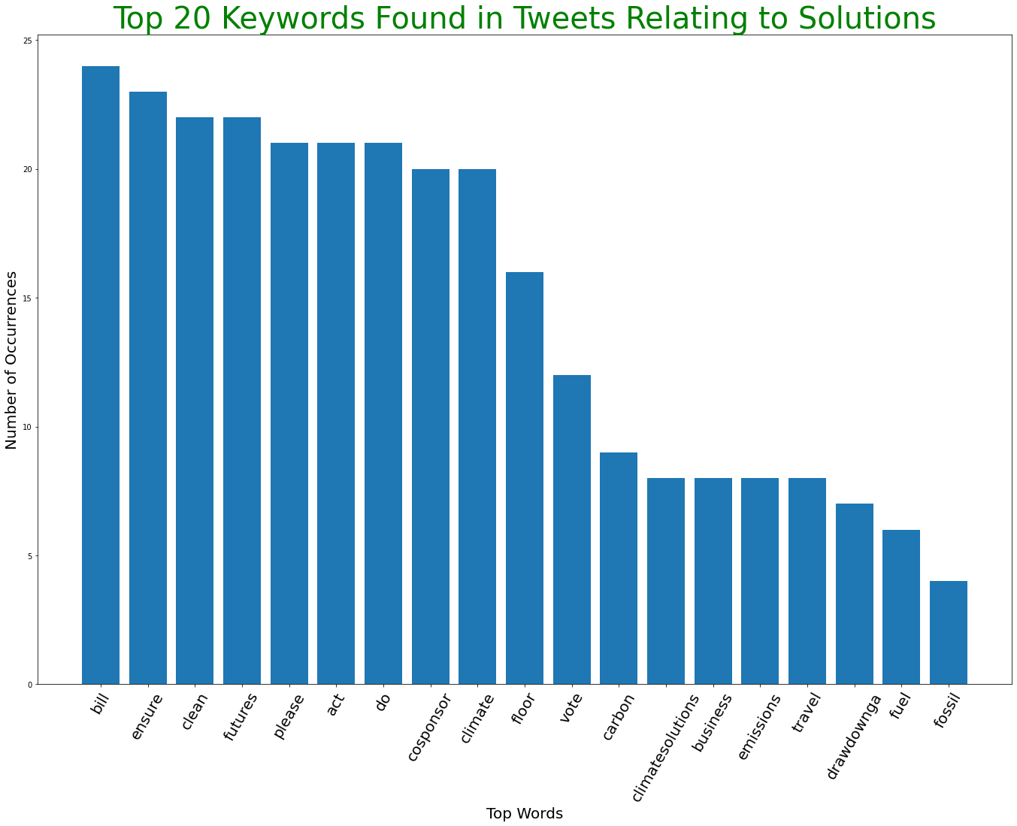
Top 20 Words Found in Solutions

Slide 30
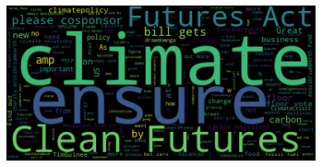
Climate Solutions
Word Cloud of Most Frequently Used Terms for solutions collection (26308 words)

Slide 31
Conclusion
Climate change believers & skeptics do use different vocabularies when talking about climate change
General sentiment was positive to informative, following the distribution of tweets pulled
Climate solutions dataset vocabularies tend to focus on congressional terms and action.

Slide 32

Thank you!

